Slide 1
Arc Reactor Yo-Yo
Team JARVIS
Notes:
smita

Slide 2


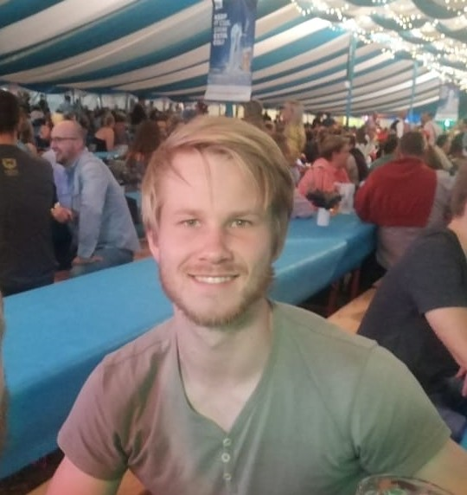
Nisal
Helen
Smita
Branden
Matthias
Notes:
smita

Slide 3
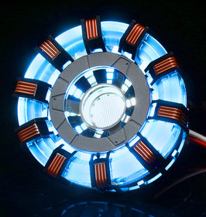
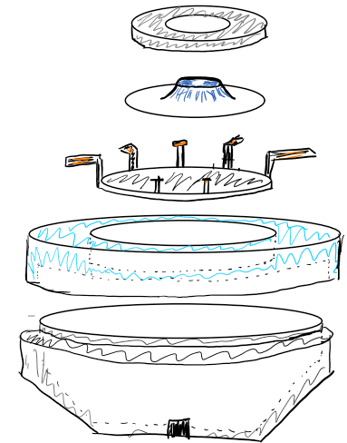
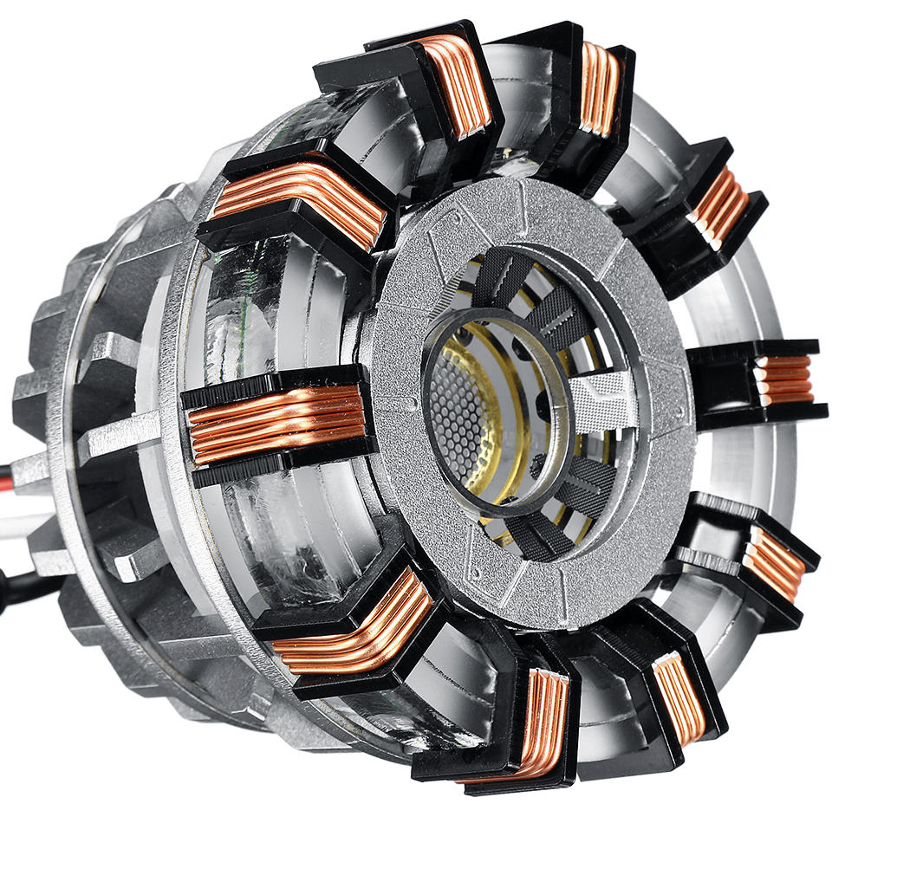
Arc Reactor
Concept
Notes:
Smita: Our inspiration was the most famous MIT alumni Iron Man. WE wanted to build the arc reactor as our yoyo face and capture all the unique features. The drawing on the right was our first design concept for creating the face of the yoyo. However we later changed our design after getting helpful feedback trhough design review and labs
[22s inc prev 2 slides]

Slide 4
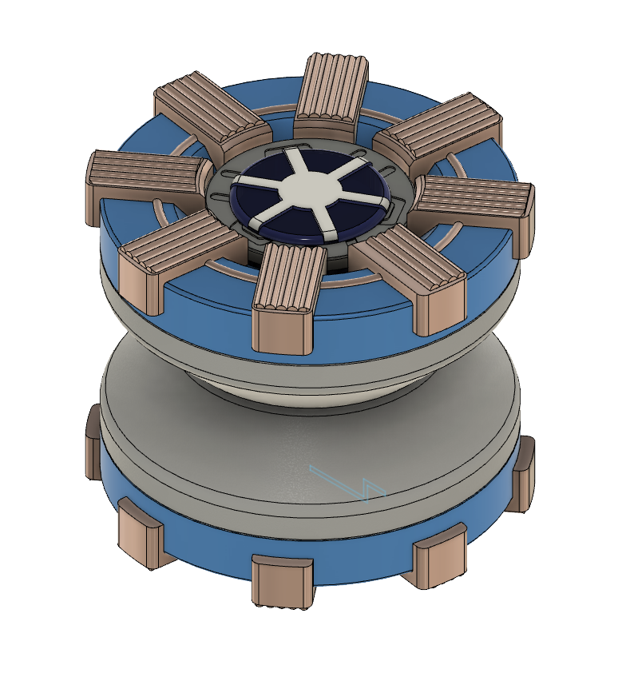
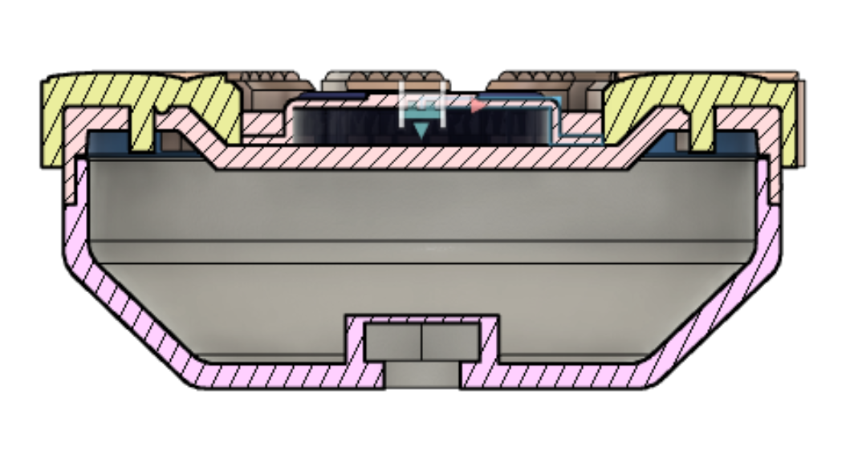
Arc Reactor
Final Design
Snap Fit
Press Fit
Notes:
Branden: This is our final design. As you can see it captures many of the main features we wanted to include such as the centerpiece and the radial coils. It consists of one 1 snap fit between the blue ring and the base and 1 press fit between the grey ring and blue ring. [10s]

Slide 5
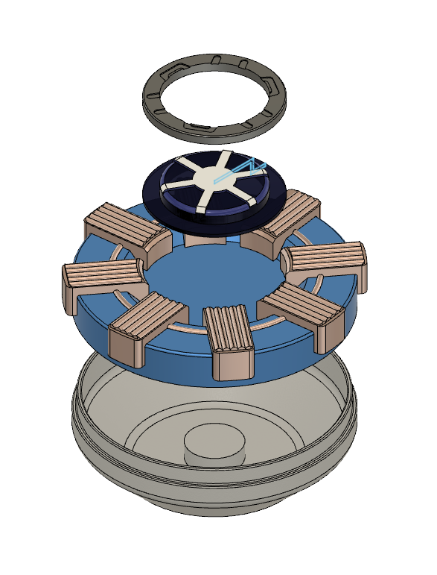
Arc Reactor
Explode
Centerpiece
Thermoformed
Gold Ring
Grey Ring
Overmolded
Injection Molded
Blue Ring
Injection Molded
Base
Injection Molded
Notes:
Branden: Here is an exploded view of the parts in our yoyo. It has three different injection molded parts, of which the gold ring is an overmolded piece onto the blue ring. There is also a thermoformed piece at the center of the Yo-Yo [11s]

Slide 6
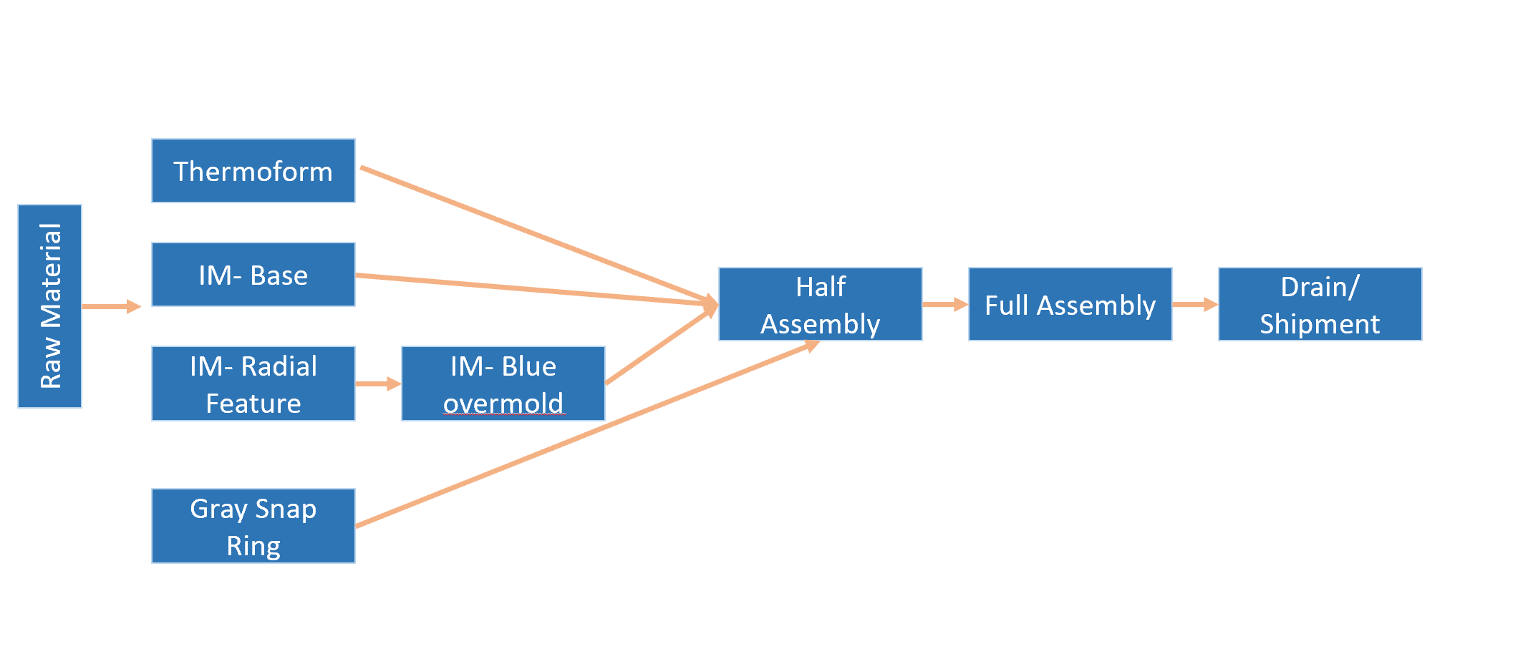
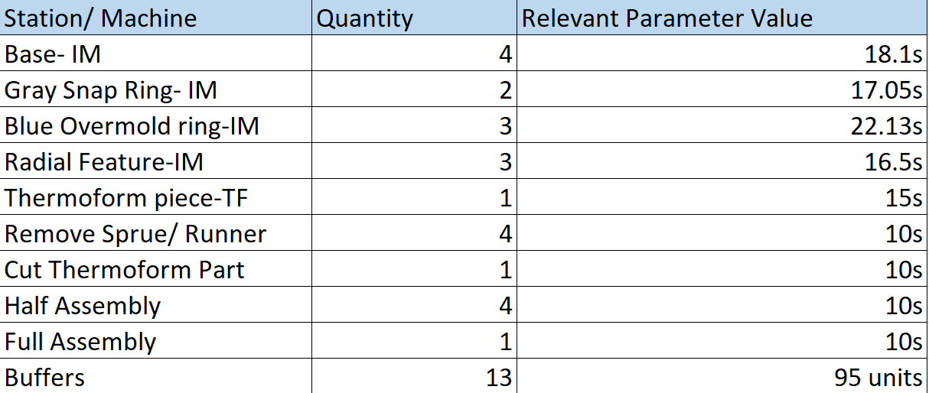
Arc Reactor
Factory Tour
Notes:
Smita: The basic flow for our factory was having the injection molding and thermofroming happening in parallel. However, The overmold piece had to be done in series after the radial feature. Then the parts go to the half assembly stations, full assembly stations and finally the shipping center. WE added machines as needed and included buffers where it made sense. After inputting the cycle times as determined earlier we were able to get a production rate of 3,889 yoyos per day which would allow us to make about 1.42 million yoyos in a year. We then tried to minimize the buffer sizes and was able to achieve a minimum buffer size of 95 [~35s]

Slide 7
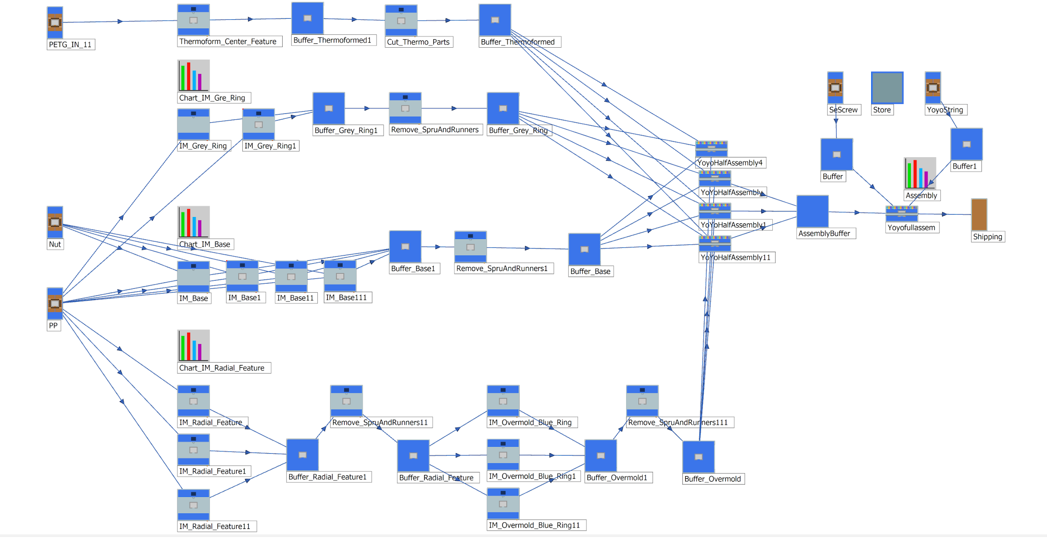
Arc Reactor
Factory Tour
3,889 yoyos/ day
2.7 yoyos/minute
1.42 million yoyos per year
Notes:
Smita: The basic flow for our factory was having the injection molding and thermofroming happening in parallel. However, The overmold piece had to be done in series after the radial feature. Then the parts go to the half assembly stations, full assembly stations and finally the shipping center. WE added machines as needed and included buffers where it made sense. After inputting the cycle times as determined earlier we were able to get a production rate of 3,889 yoyos per day which would allow us to make about 1.42 million yoyos in a year. We then tried to minimize the buffer sizes and was able to achieve a minimum buffer size of 95 [~35s]

Slide 8
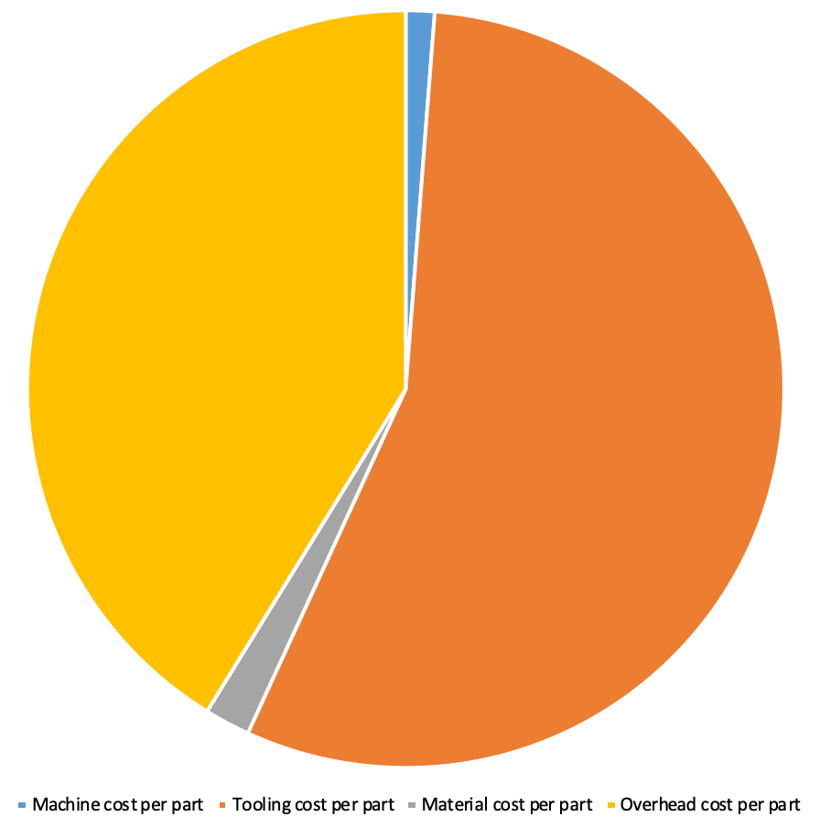
Arc Reactor
Cost Analysis
Part Cost @ production level of 1,400,000 | Cost ($)
Base | 0.50
Radial Ring | 0.43
Blue Snap Ring | 0.44
Grey Snap Ring | 0.37
Center Feature | 0.08
Nuts | 0.10
String | 0.05
Threaded rod | 0.15
Assembly Cost @ production level
Assembly Worker | $15/hour
Time to assembly Yo-yo | 1min
Total cost per Yo-Yo | 0.25
Total Cost | $2.36
Cost Distribution: Blue Ring
Notes:
Branden: To come up with our YoYo Total Cost, we came up with the Individual cost per part at a production level of 1.4 million (which is the output of our simulation). We included a brief Analysis of Assembly costs to get a total Yo-Yo cost of $2.36. If we look at the cost distribution of our Blue Ring Part, we see that most of our costs are the tooling cost and also labor costs. Material and Machine costs are very small components of the total cost. [~25s]

Slide 9
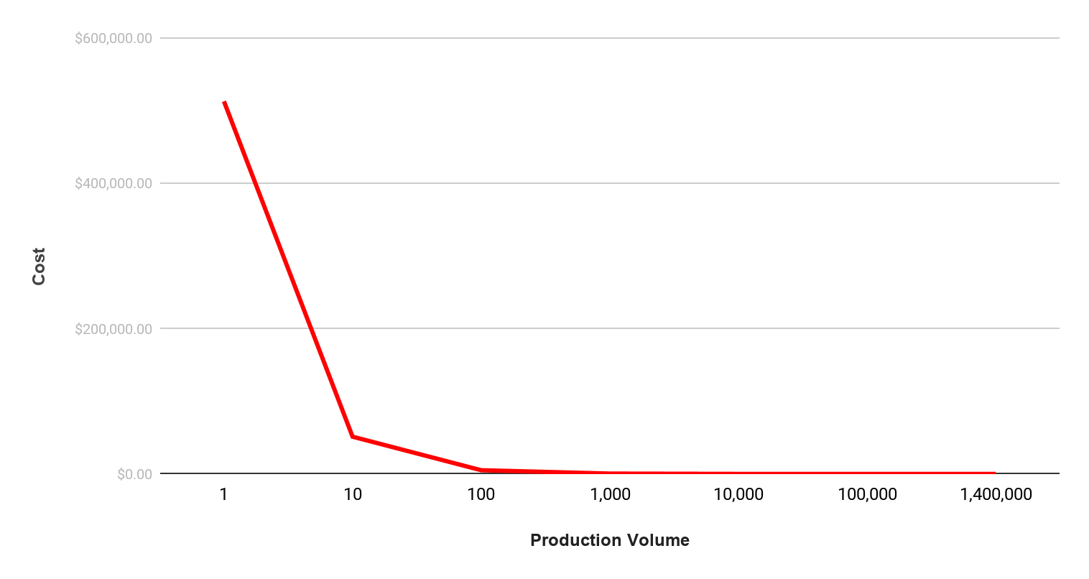
Arc Reactor
Cost Analysis
100x Volume at 1/10 cost
Notes:
Branden: This slide here answers the question: can we produce at 1/10 the cost at 100x the current volume. We see that the cost vs. quantity curve approaches an asymptote, so we don’t think that we wouldn’t be able to produce at 1/10 the cost without changing the variable costs. [~15s]

Slide 10
Questions?

